Slide 1

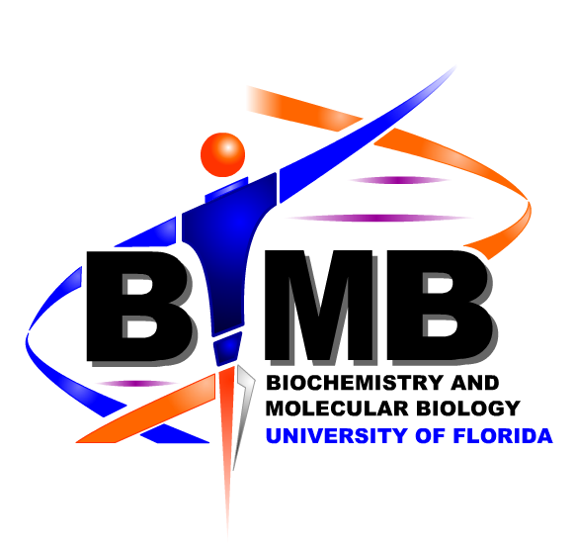
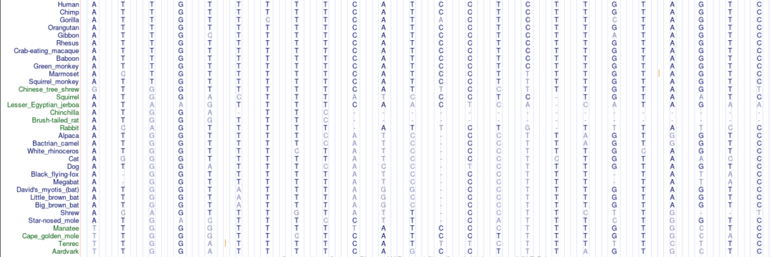
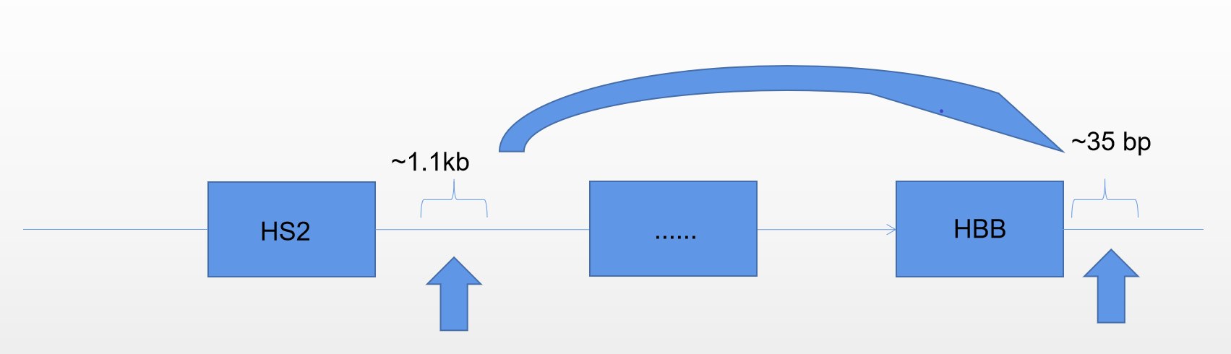
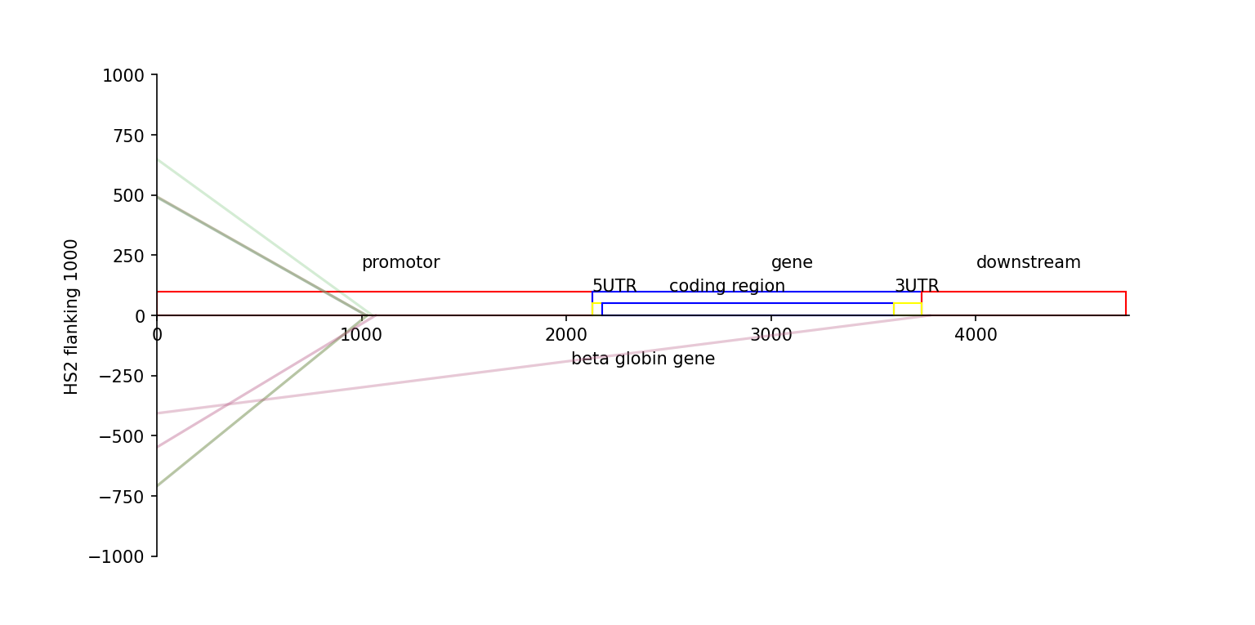
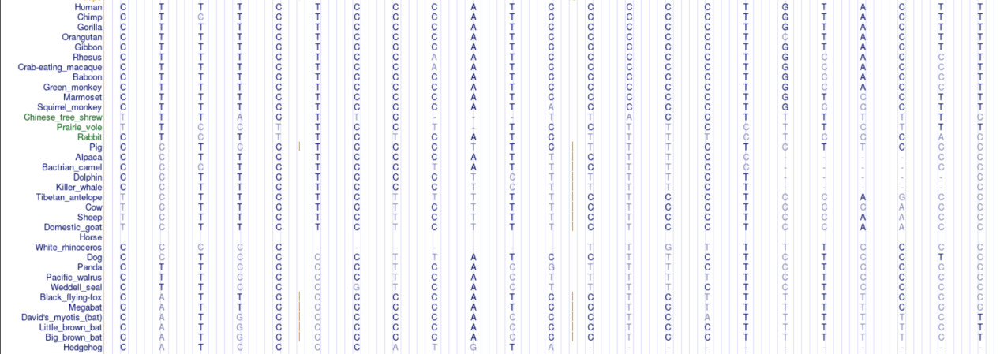
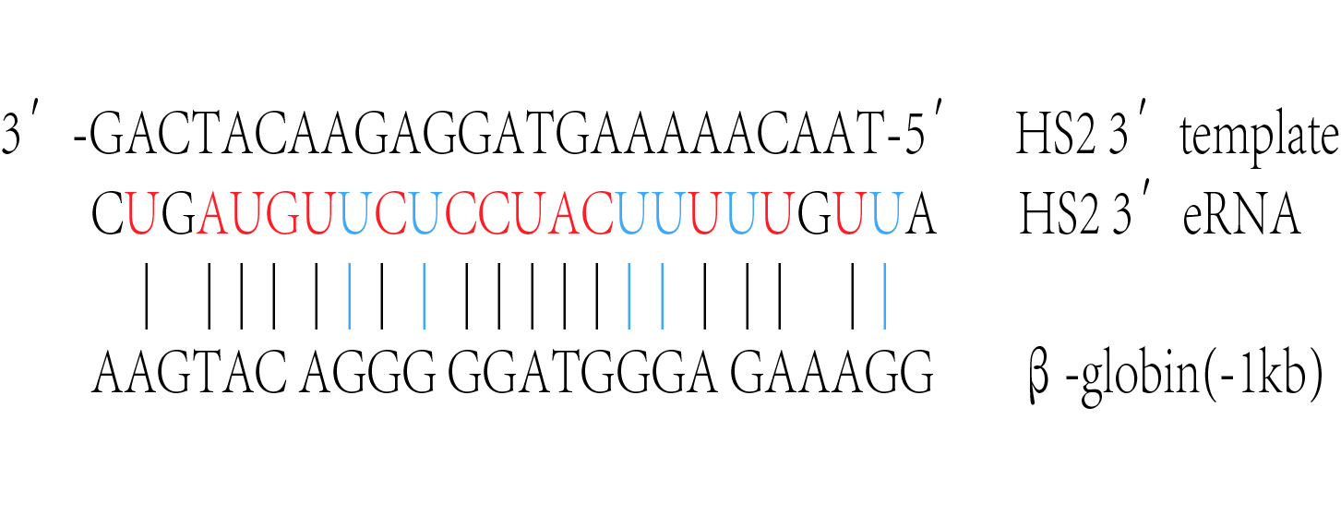
The role of non-coding, enhancer associated, RNA (eRNA) in β-globin gene regulation
Fang Yu, Matthew Gibbons, Austin Spicola, Niko Linzer, Stephen P. Jones, Aishwarya Gurumurthy, Mingyi Xie, and Jörg Bungert
Department of Biochemistry and Molecular Biology, UF Health Cancer Center, Genetics Institute, College of Medicine, University of Florida, Gainesville, FL 32610, USA.
Abstract
LCR associated eRNA
LCR HS2 3’RNA
The hypersensitive sites (HSs) associated with the β-globin locus control region (LCR) recruit RNA polymerase II (Pol II) transcription complexes and initiate transcription of eRNAs. Previous studies implicated LCR associated eRNA in the regulation of β-type globin genes. These non-coding RNAs could participate in RNA induced formation of a transcription initiation domain, which concentrates co-regulators and Pol II at the LCR super-enhancer, and/or they could engage in sequence specific interactions with other non-coding RNA or with DNA in the β-globin gene locus. We examined the sequence conservation of LCR associated eRNAs and found blocks of highly conserved sequences associated with HS2 and HS3 eRNAs. Examining their potential to interact with other sequences in the globin gene locus identified clusters of putative interactions with globin gene associated RNA or DNA. We will present preliminary data on these interactions and propose that eRNAs together with proteins mediate transient interactions of the globin genes with LCR seeded transcription initiation domains. These transient interactions allow transfer of components of the transcription complex, including Pol II, from the LCR transcription initiation domain to high-affinity basal globin gene promoters.
HS2
HS2 3’eRNA
β-globin
shRNA(A)
shRNA(B)
β-maj
HS2 3’eRNA
GATA1
*
*
*
*
Relative expression to GATA1
Relative expression to β-Actin
Scramble
3’ HS2 (A)
3’ HS2 (B)
Scramble
3’ HS2 (A)
3’ HS2 (B)
Scramble
3’ HS2 (A)
3’ HS2 (B)
Murine HS2 3’eRNA reveals a half-life of about 9 minutes, remains
associated with the b-globin gee locus and is required for high level
βmaj-globin gene expression.
(Gurumurthy et al., Nucl. Acids. Res., 2021)
Base pairing complementarity of HS2 eRNA and β-globin gene
Conservation of DNA sequences 3’ of HS2 and 1Kb upstream of the β-globin gene
Triple helix formation potential of HS2 3’ eRNA and
a β-globin gene 3’sequence
We searched for potential interactions between HS2 5’ and 3’ eRNA taking into consideration Watson-Crick base pairing plus G:U base pairing (found in RNA:DNA and RNA:RNA interactions).
HS2 3’ sequence
Coding strand
3’AAGAAAGGAAATCAACCTGAAGAGTATTTATACAGATAACAAAATACAGAGAGTGAGTTAAATGTGTAATAACTGTG5′
3′AAAAGGGAATGTGGGAGGTCAGTGCATTTAAAACATAAAGAAATGAAGAGCTAGTTCAAACCTTGGGAAAATAC5′
β-globin -1Kb sequence
Tool:longtarget
Longtarget(He S, Zhang H, Liu H, Zhu H. LongTarget: a tool to predict lncRNA DNA-binding motifs and binding sites via Hoogsteen base-pairing analysis. Bioinformatics. 2015)
Summary – Acknowledgements - Funding
Summary and Future Directions: We provide evidence that LCR associated eRNA plays a functional in globin gene regulation. The bioinformatic analysis points to the possibility that eRNA may function
together with proteins to mediate transient interactions between the LCR transcription domain and the globin gene promoters. These transient interactions would allow transfer of Pol II and other basal
transcription factors from the LCR transcription domain to the globin gene promoters. We are currently verifying RNA:RNA and RNA:DNA interactions in vitro and in the context of erythroid cells.
We also initiated experiments to examine the functional role of specific LCR associated eRNA sequences and the corresponding sequences in the β-globin gene region.
Acknowledgements: We thank our colleagues in the Xie and Bungert laboratory for fruitful discussions and assistance.
Funding: This work was supported by a grant from the American Society of Hematology and matching funds from the UF College of Medicine (to J.B.)

